Slide 1

POSCAT Seminar 6 : Greedy Approach
yougatup @ POSCAT

Slide 2
Topic
Topic today
Greedy Approach
Basic Concept
Interval Scheduling
Interval Partitioning
Fractional Knapsack
Huffman Encoding
Other Problems

Slide 3
Greedy Approach
Problem Solving Paradigm
Follows the problem solving heuristic of making the locally optimal choose at each stage
You should prove that greedy approach guarantees the global optimal
Very difficult normally
Finding a solution is very difficult, but
Code is very simple because it choose locally optimal usually

Slide 4
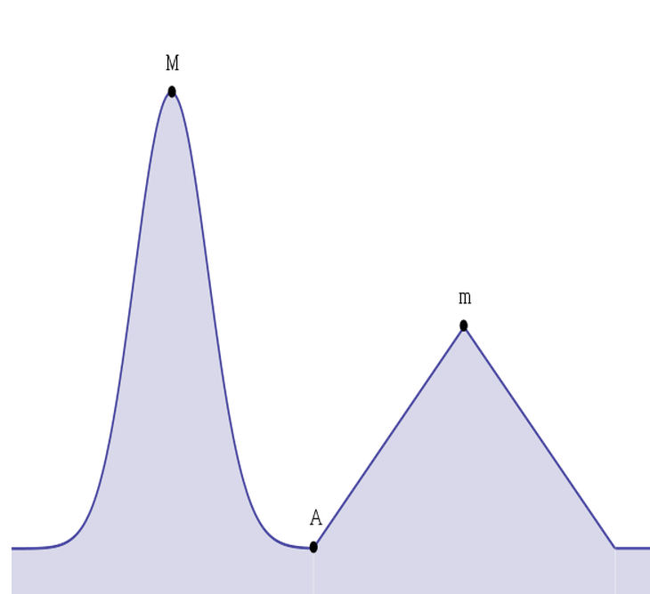
Greedy Approach
Starting at A, our greedy algorithm should find ‘M’, not ‘m’.
Therefore, we must prove that greedy algorithm always find ‘M’, although we always choose locally optimal path

Slide 5
Greedy Approach
Problem
Find a path which has largest sum
7
3
6
9
2
1
2

Slide 6
Greedy Approach
Problem
Find a path which has largest sum
Greedy approach : Choose what appears to be the optimal
7
3
6
9
2
1
2

Slide 7
Greedy Approach
Problem
Find a path which has largest sum
Greedy approach : Choose what appears to be the optimal
7
3
6
9
2
1
2

Slide 8
Greedy Approach
Problem
Find a path which has largest sum
Greedy approach : Choose what appears to be the optimal
7
3
6
9
2
1
2

Slide 9
Greedy Approach
Problem
Find a path which has largest sum
Greedy approach : Choose what appears to be the optimal
Is it our solution ?
7
3
6
9
2
1
2

Slide 10
Greedy Approach
Problem
Find a path which has largest sum
Greedy approach : Choose what appears to be the optimal
Is it our solution ?
7
3
6
9
2
1
2

Slide 11
Greedy Approach
Problem
Find a path which has largest sum
Greedy approach : Choose what appears to be the optimal
We must prove that our choice guarantees global optimal value
7
3
6
9
2
1
2

Slide 12
Greedy Approach
Problem
Find a path which has largest sum
Greedy approach : Choose what appears to be the optimal
We must prove that our choice guarantees global optimal value
Completely Wrong !
7
3
6
9
2
1
2

Slide 13

Interval Scheduling
Problem
Job $j$ starts at $s_{j}$ and finishes at $f_{j}$
Two jobs compatible if they don’t overlap
Find maximum subset of mutually compatible jobs
Time

Slide 14
Interval Scheduling
Problem
Job $j$ starts at $s_{j}$ and finishes at $f_{j}$
Two jobs compatible if they don’t overlap
Find maximum subset of mutually compatible jobs
Time
They don’t overlap each other.

Slide 15
Interval Scheduling
Problem
Idea : What have to be the first interval ?
Time

Slide 16
Interval Scheduling
Problem
Idea : What have to be the first interval ?
Which one is better ? Why ?
Time

Slide 17
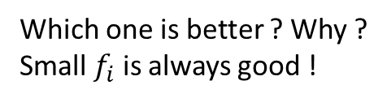
Interval Scheduling
Problem
Idea : What have to be the first interval ?
Which one is better ? Why ?
Small $f_{i}$ is always good !
Time

Slide 18
Interval Scheduling
Problem
Idea : What have to be the first interval ?
It must be the first one definitely !
Time

Slide 19
Interval Scheduling
Problem
Idea : What have to be the first interval ?
Time
We can’t choose grey interval → remove it

Slide 20
Interval Scheduling
Problem
Idea : What have to be the first interval ?
Time
We can’t choose grey interval → remove it

Slide 21
Interval Scheduling
Problem
Idea : What have to be the first interval ?
Time
Which one is better ?

Slide 22
Interval Scheduling
Problem
Idea : What have to be the first interval ?
Time
Which one is better ?

Slide 23
Interval Scheduling
Problem
Idea : What have to be the first interval ?
Time
Which one is better ?

Slide 24
Interval Scheduling
Problem
Idea : What have to be the first interval ?
Time
Which one is better ?

Slide 25
Interval Scheduling
Problem
Idea : What have to be the first interval ?
Time
Which one is better ?

Slide 26
Interval Scheduling
Problem
Idea : What have to be the first interval ?
Time
Done ! You should know why greedy algorithm guarantees the global optimal

Slide 27
Interval Scheduling
Problem
Prove that this algorithm is optimal
Done ! You should know why greedy algorithm guarantees the global optimal

Slide 28

Interval Scheduling
Problem
Prove that this algorithm is optimal
Suppose that there is a solution $s_{1}≤f_{1}≤s_{2}≤f_{2}≤ …≤s_{k}≤f_{k}$, and we found $s_{1}^{′}≤f_{1}^{′}≤s_{2}^{′}≤f_{2}^{′}≤ …≤s_{opt}^{′}≤f_{opt}′$
Done ! You should know why greedy algorithm guarantees the global optimal

Slide 29
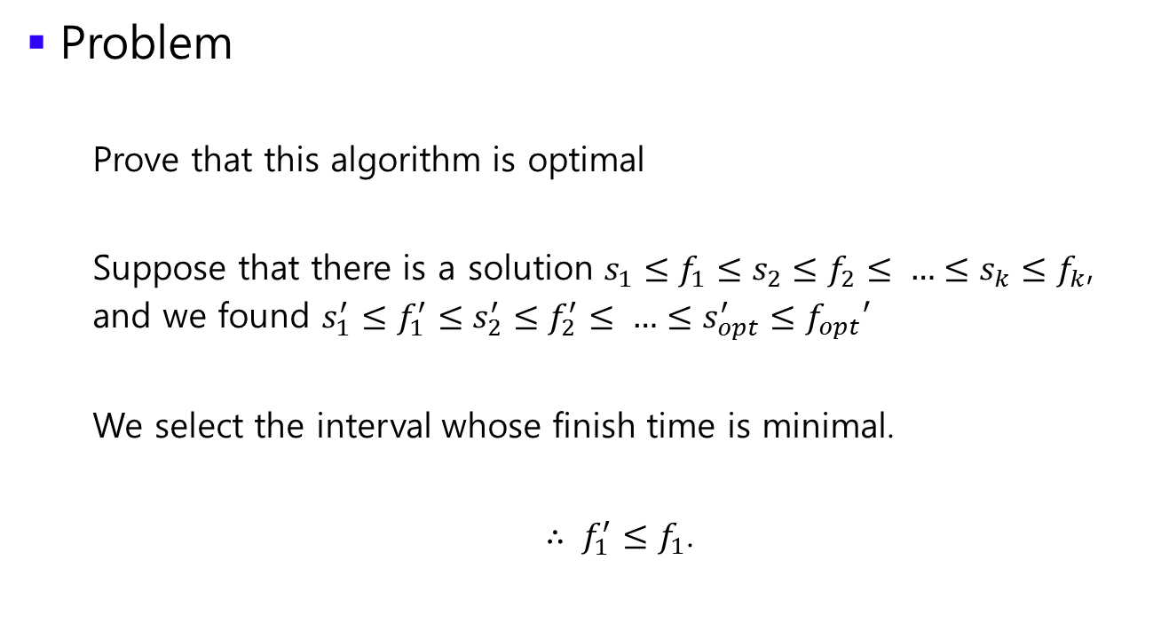
Interval Scheduling
Problem
Prove that this algorithm is optimal
Suppose that there is a solution $s_{1}≤f_{1}≤s_{2}≤f_{2}≤ …≤s_{k}≤f_{k}$, and we found $s_{1}^{′}≤f_{1}^{′}≤s_{2}^{′}≤f_{2}^{′}≤ …≤s_{opt}^{′}≤f_{opt}′$
We select the interval whose finish time is minimal.
$∴ f_{1}^{′}≤f_{1}$.
Done ! You should know why greedy algorithm guarantees the global optimal

Slide 30
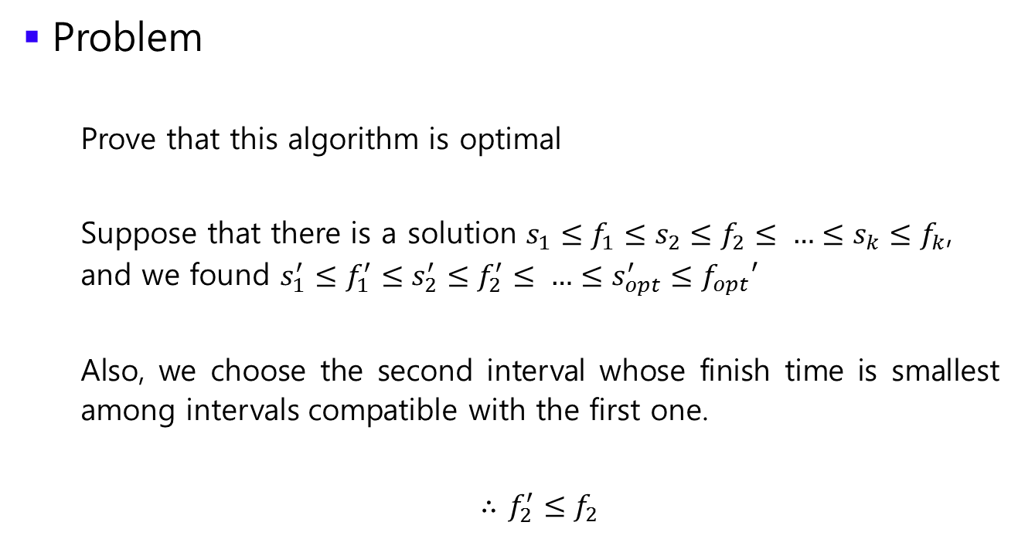
Interval Scheduling
Problem
Prove that this algorithm is optimal
Suppose that there is a solution $s_{1}≤f_{1}≤s_{2}≤f_{2}≤ …≤s_{k}≤f_{k}$, and we found $s_{1}^{′}≤f_{1}^{′}≤s_{2}^{′}≤f_{2}^{′}≤ …≤s_{opt}^{′}≤f_{opt}′$
Also, we choose the second interval whose finish time is smallest among intervals compatible with the first one.
$∴$ $f_{2}^{′}≤f_{2}$
Done ! You should know why greedy algorithm guarantees the global optimal

Slide 31
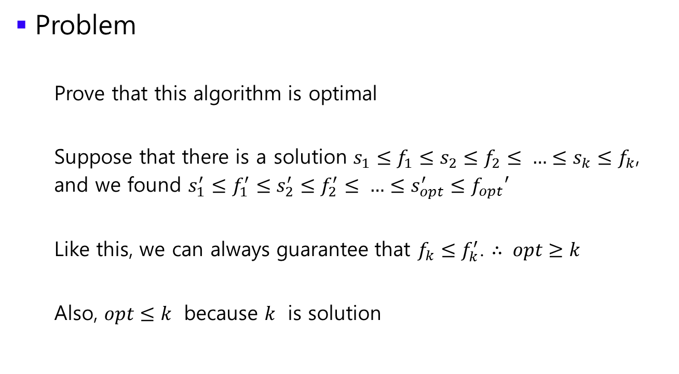
Interval Scheduling
Problem
Prove that this algorithm is optimal
Suppose that there is a solution $s_{1}≤f_{1}≤s_{2}≤f_{2}≤ …≤s_{k}≤f_{k}$, and we found $s_{1}^{′}≤f_{1}^{′}≤s_{2}^{′}≤f_{2}^{′}≤ …≤s_{opt}^{′}≤f_{opt}′$
Like this, we can always guarantee that $f_{k}≤f_{k}^{′}$. $∴ opt≥k$
Also, $opt≤k$ because $k$ is solution
Done ! You should know why greedy algorithm guarantees the global optimal

Slide 32
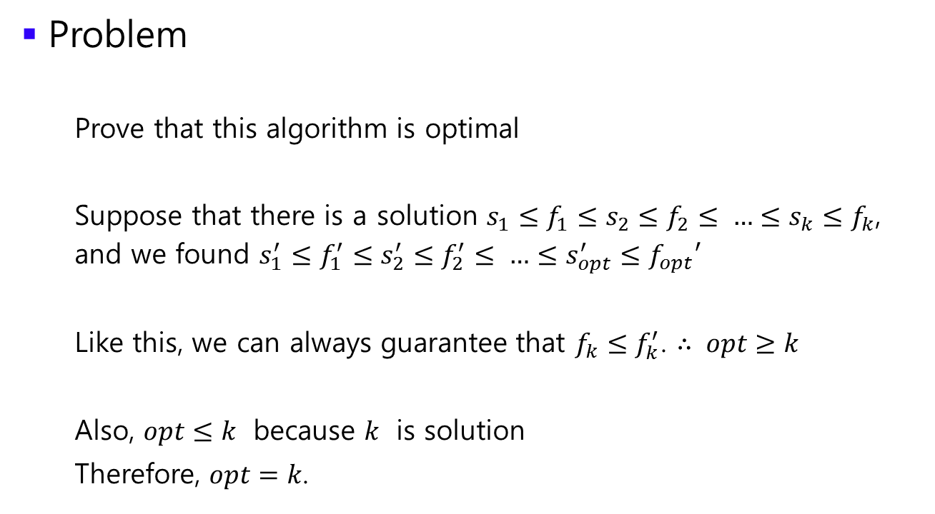
Interval Scheduling
Problem
Prove that this algorithm is optimal
Suppose that there is a solution $s_{1}≤f_{1}≤s_{2}≤f_{2}≤ …≤s_{k}≤f_{k}$, and we found $s_{1}^{′}≤f_{1}^{′}≤s_{2}^{′}≤f_{2}^{′}≤ …≤s_{opt}^{′}≤f_{opt}′$
Like this, we can always guarantee that $f_{k}≤f_{k}^{′}$. $∴ opt≥k$
Also, $opt≤k$ because $k$ is solution
Therefore, $opt=k$.
Done ! You should know why greedy algorithm guarantees the global optimal

Slide 33

Interval Scheduling
Problem
Idea : What have to be the first interval ?
Time
Time complexity : O($n log n$) for sorting

Slide 34

Interval Partitioning
Problem
Lecture $j$ starts at $s_{j}$ and finishes at $f_{j}$
Find minimum number of classrooms to schedule all lectures so that no two occur at the same time in the same room
Time

Slide 35
Interval Partitioning
Problem
Lecture $j$ starts at $s_{j}$ and finishes at $f_{j}$
Find minimum number of classrooms to schedule all lectures so that no two occur at the same time in the same room
Time

Slide 36
Interval Partitioning
Problem
Lecture $j$ starts at $s_{j}$ and finishes at $f_{j}$
Find minimum number of classrooms to schedule all lectures so that no two occur at the same time in the same room
Time

Slide 37
Interval Partitioning
Problem
Lecture $j$ starts at $s_{j}$ and finishes at $f_{j}$
Find minimum number of classrooms to schedule all lectures so that no two occur at the same time in the same room
Time

Slide 38
Interval Partitioning
Problem
Lecture $j$ starts at $s_{j}$ and finishes at $f_{j}$
Find minimum number of classrooms to schedule all lectures so that no two occur at the same time in the same room
Time

Slide 39
Interval Partitioning
Problem
Lecture $j$ starts at $s_{j}$ and finishes at $f_{j}$
Find minimum number of classrooms to schedule all lectures so that no two occur at the same time in the same room
Time

Slide 40
Interval Partitioning
Problem
Lecture $j$ starts at $s_{j}$ and finishes at $f_{j}$
Find minimum number of classrooms to schedule all lectures so that no two occur at the same time in the same room
Time
We need 5 classrooms !

Slide 41
Interval Partitioning
Problem
Idea : What is the minimum number of classrooms ?
Time

Slide 42
Interval Partitioning
Problem
Idea : What is the minimum number of classrooms ?
We don’t know the solution, but we need at least 4 classrooms! → Is it sufficient ?
Time

Slide 43
Interval Partitioning
Problem
Idea : What is the minimum number of classrooms ?
We don’t know the solution, but we need at least 5 classrooms!
Time

Slide 44

Interval Partitioning
Problem
Idea : What is the minimum number of classrooms ?
$∴$ We need classrooms at least as many as the maximum number of overlap
We don’t know the solution, but we need at least 5 classrooms!
Time

Slide 45
Interval Partitioning
Problem
Is it sufficient ?
Time

Slide 46
Interval Partitioning
Problem
Is it sufficient ? Yes ! Consider this algorithm
Time

Slide 47
Interval Partitioning
Problem
Is it sufficient ? Yes ! Consider this algorithm
Time

Slide 48
Interval Partitioning
Problem
Is it sufficient ? Yes ! Consider this algorithm
Time

Slide 49
Interval Partitioning
Problem
Is it sufficient ? Yes ! Consider this algorithm
Time

Slide 50
Interval Partitioning
Problem
Is it sufficient ? Yes ! Consider this algorithm
Time

Slide 51
Interval Partitioning
Problem
Is it sufficient ? Yes ! Consider this algorithm
I can reuse this color !
Time

Slide 52
Interval Partitioning
Problem
Is it sufficient ? Yes ! Consider this algorithm
I can reuse this color !
Time

Slide 53
Interval Partitioning
Problem
Is it sufficient ? Yes ! Consider this algorithm
I can reuse this color !
Time

Slide 54
Interval Partitioning
Problem
Is it sufficient ? Yes ! Consider this algorithm
I can reuse this color !
Time

Slide 55
Interval Partitioning
Problem
Is it sufficient ? Yes ! Consider this algorithm
Done !
Time

Slide 56
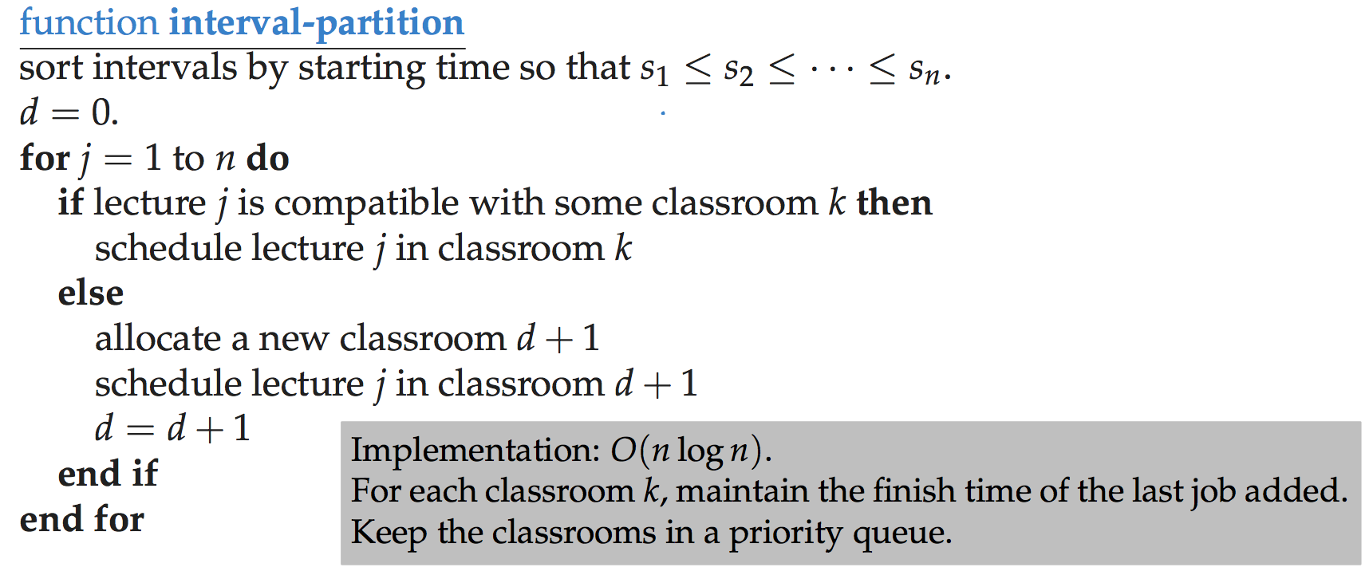
Interval Partitioning
Prove that this algorithm needs classrooms no more than the maximum number of overlap

Slide 57
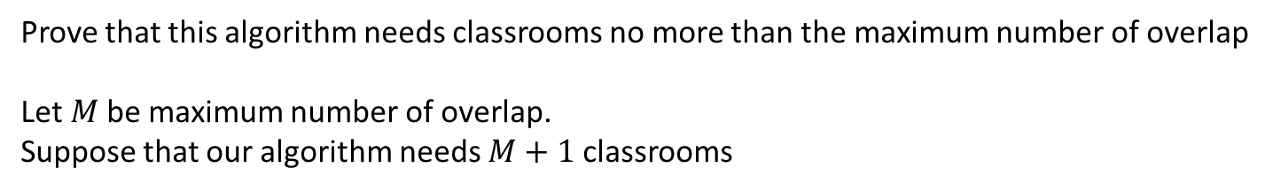
Interval Partitioning
Prove that this algorithm needs classrooms no more than the maximum number of overlap
Let $M$be maximum number of overlap.
Suppose that our algorithm needs $M+1$classrooms

Slide 58
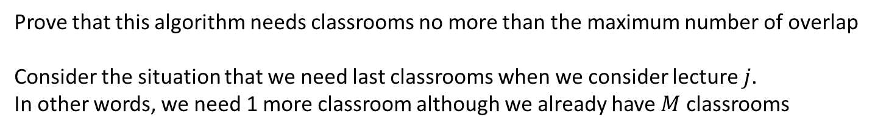
Interval Partitioning
Prove that this algorithm needs classrooms no more than the maximum number of overlap
Consider the situation that we need last classrooms when we consider lecture $j$.
In other words, we need 1 more classroom although we already have $M$ classrooms

Slide 59
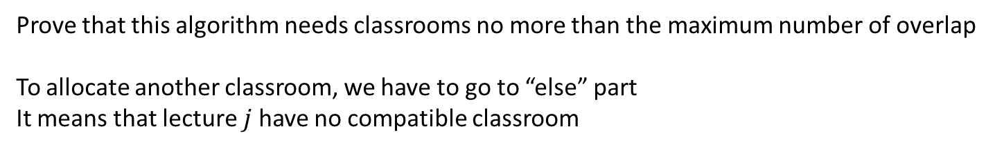
Interval Partitioning
Prove that this algorithm needs classrooms no more than the maximum number of overlap
To allocate another classroom, we have to go to “else” part
It means that lecture $j$ have no compatible classroom

Slide 60
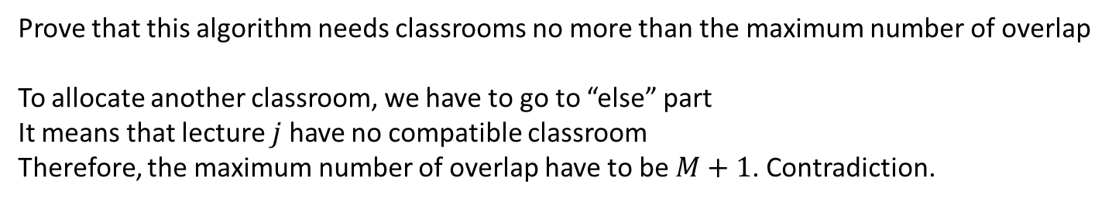
Interval Partitioning
Prove that this algorithm needs classrooms no more than the maximum number of overlap
To allocate another classroom, we have to go to “else” part
It means that lecture $j$ have no compatible classroom Therefore, the maximum number of overlap have to be $M+1$. Contradiction.

Slide 61
Interval Partitioning
Implementation ?

Slide 62
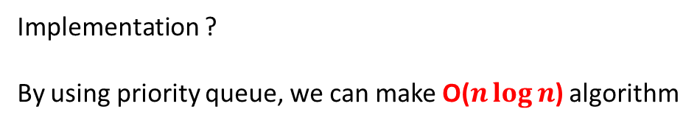
Interval Partitioning
Implementation ?
By using priority queue, we can make O($n\log{n}$) algorithm

Slide 63
Fractional Knapsack
Easy, just think about it
I’ll provide this problem today

Slide 64

Other problems
Problem
Given N points, find a maximum value of $m$ such that $m=|\frac{∆y}{∆x}|$

Slide 65

Other problems
Problem
Given N points, find a maximum value of $m$ such that $m=|\frac{∆y}{∆x}|$
Naïve approach → O($n^{2}$)

Slide 66

Other problems
Problem
Given N points, find a maximum value of $m$ such that $m=|\frac{∆y}{∆x}|$
We can prove that two points have to be adjacent
It can’t be optimal !

Slide 67

Other problems
Problem
Given N points, find a maximum value of $m$ such that $m=|\frac{∆y}{∆x}|$
We can prove that two points have to be adjacent → O($n\log{n}$)
It can’t be optimal !

Slide 68
Other problems
Problem
You have 2N cards, and each card have two numbers on both sides.
There are 2N locations to put your card on the table. For each location, it has specific sign which is changed alternatively (+ or -).
Find the maximum value of the result of your calculation.
Locations :
+
-
+
-
+
-
=
?
Cards (front/back)
1
2
9
-1
-9
-8
7
4
4
-3
2
-1

Slide 69
Other problems
Problem
You have 2N cards, and each card have two numbers on both sides.
There are 2N locations to put your card on the table. For each location, it has specific sign which is changed alternatively (+ or -).
Find the maximum value of the result of your calculation.
Locations :
+
-
+
-
+
-
=
?
Cards (front/back)
1
2
9
-1
-9
-8
7
4
4
-3
2
-1

Slide 70
Other problems
Problem
You have 2N cards, and each card have two numbers on both sides.
There are 2N locations to put your card on the table. For each location, it has specific sign which is changed alternatively (+ or -).
Find the maximum value of the result of your calculation.
Locations :
+
2
-
-3
+
9
-
-9
+
7
-
-1
=
31
Cards (front/back)
1
-1
-8
4
4
2

Slide 71

Other problems
Solution
Let $a_{i}$ be the value of bigger side of card $i$.
$b_{i}$ be the value of smaller side of card $i$.
If card $i$ which is located with (+) should have the value $a_{i}$
Otherwise, it should have the value $b_{i}$

Slide 72
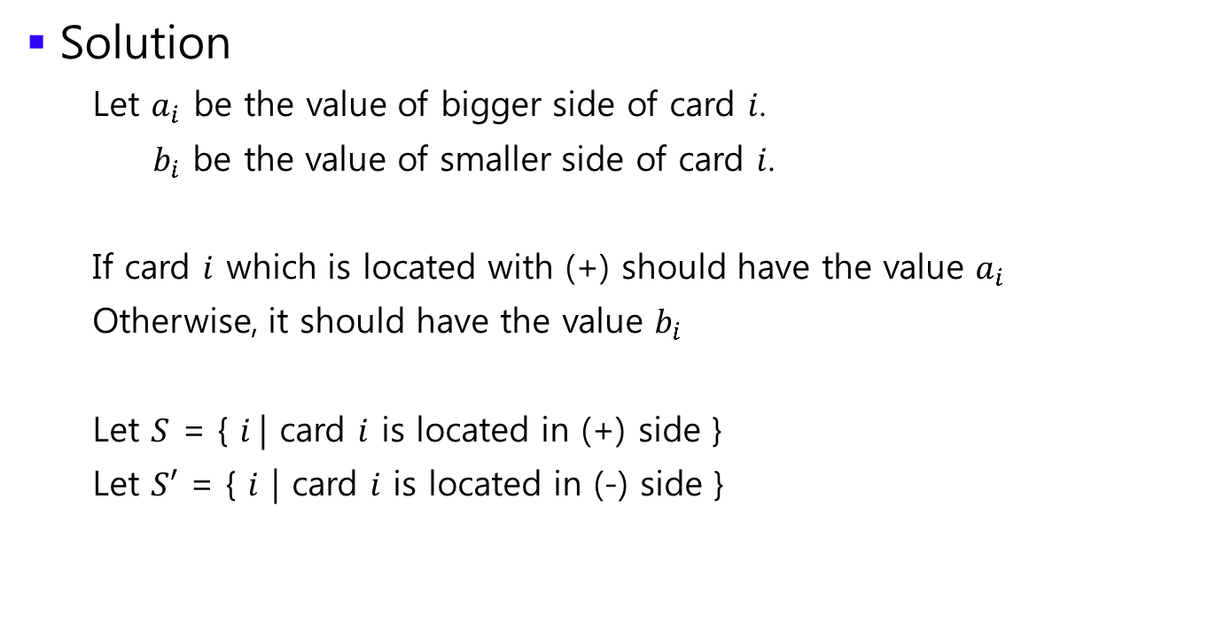
Other problems
Solution
Let $a_{i}$ be the value of bigger side of card $i$.
$b_{i}$ be the value of smaller side of card $i$.
If card $i$ which is located with (+) should have the value $a_{i}$
Otherwise, it should have the value $b_{i}$
Let $S$ = { $i$| card $i$ is located in (+) side }
Let $S′$ = { $i$ | card $i$ is located in (-) side }

Slide 73

Other problems
Solution
Let $a_{i}$ be the value of bigger side of card $i$.
$b_{i}$ be the value of smaller side of card $i$.
Then our result is represented by
$$\sum_{i∈S}{a_{i}}− \sum_{j∈S′}{b_{j}}$$

Slide 74
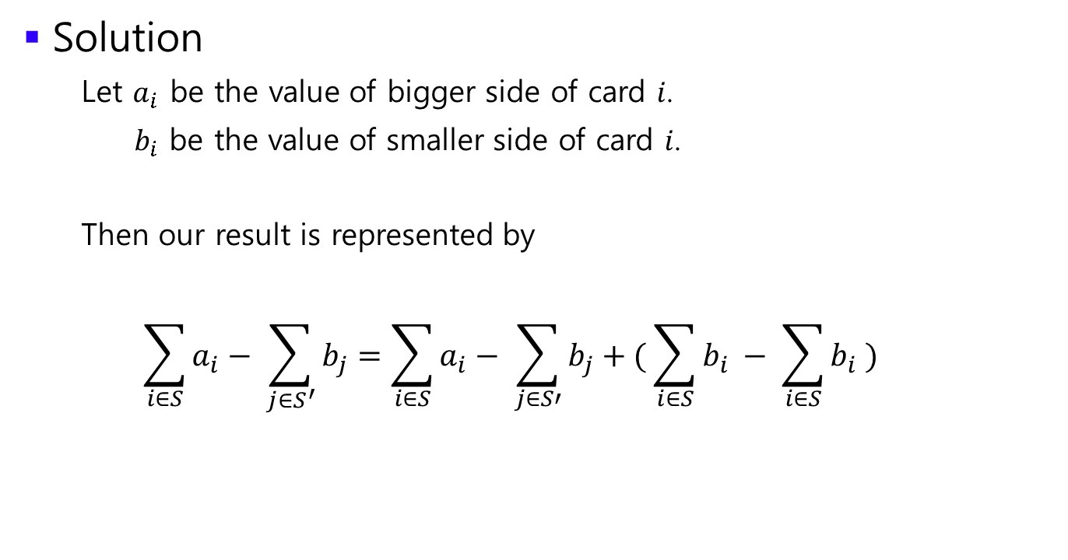
Other problems
Solution
Let $a_{i}$ be the value of bigger side of card $i$.
$b_{i}$ be the value of smaller side of card $i$.
Then our result is represented by
$$\sum_{i∈S}{a_{i}}− \sum_{j∈S^{′}}{b_{j}}=\sum_{i∈S}{a_{i}}− \sum_{j∈S′}{b_{j}}+( \sum_{i∈S}{b_{i}} − \sum_{i∈S}{b_{i}} )$$

Slide 75
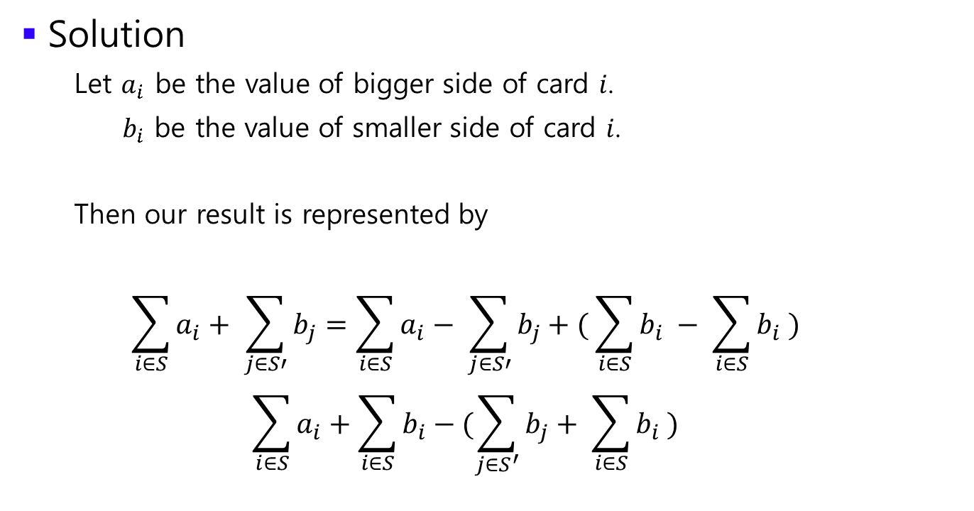
Other problems
Solution
Let $a_{i}$ be the value of bigger side of card $i$.
$b_{i}$ be the value of smaller side of card $i$.
Then our result is represented by
$$\sum_{i∈S}{a_{i}}+ \sum_{j∈S′}{b_{j}}=\sum_{i∈S}{a_{i}}− \sum_{j∈S′}{b_{j}}+( \sum_{i∈S}{b_{i}} − \sum_{i∈S}{b_{i}} )$$
$$\sum_{i∈S}{a_{i}}+\sum_{i∈S}{b_{i}}−(\sum_{j∈S^{′}}{b_{j}}+ \sum_{i∈S}{b_{i}} )$$

Slide 76
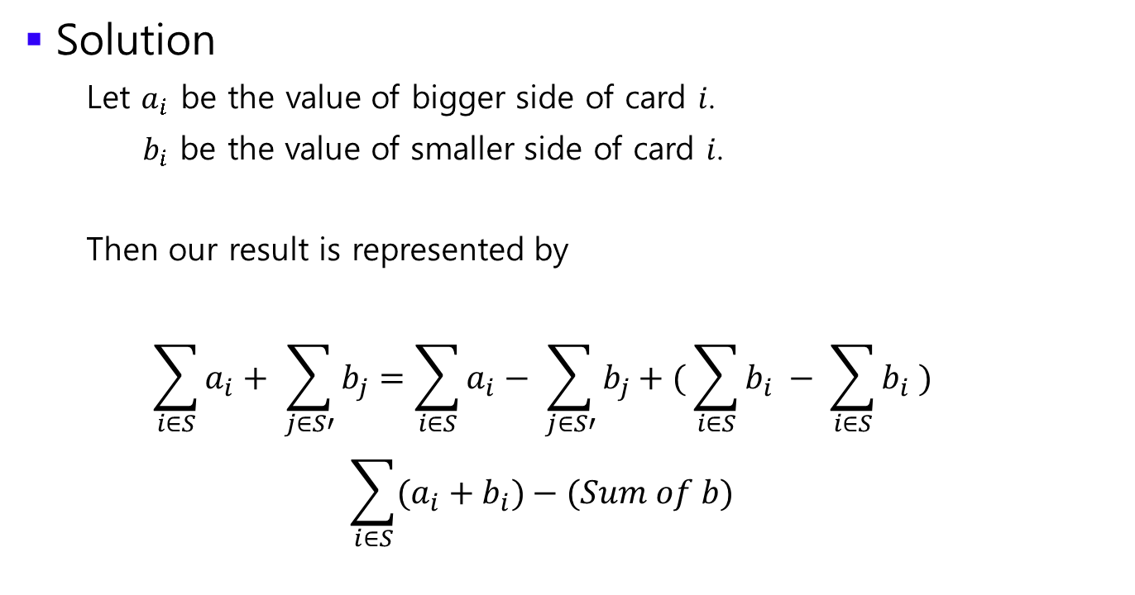
Other problems
Solution
Let $a_{i}$ be the value of bigger side of card $i$.
$b_{i}$ be the value of smaller side of card $i$.
Then our result is represented by
$$\sum_{i∈S}{a_{i}}+ \sum_{j∈S′}{b_{j}}=\sum_{i∈S}{a_{i}}− \sum_{j∈S′}{b_{j}}+( \sum_{i∈S}{b_{i}} − \sum_{i∈S}{b_{i}} )$$
$$\sum_{i∈S}{(a_{i}+b_{i})}−(Sum of b)$$

Slide 77

Other problems
Solution
Let $a_{i}$ be the value of bigger side of card $i$.
$b_{i}$ be the value of smaller side of card $i$.
$$\sum_{i∈S}{(a_{i}+b_{i})}−(Sum of b)$$
(Sum of $b$) is constant because $b$ is the smaller value of each card.

Slide 78
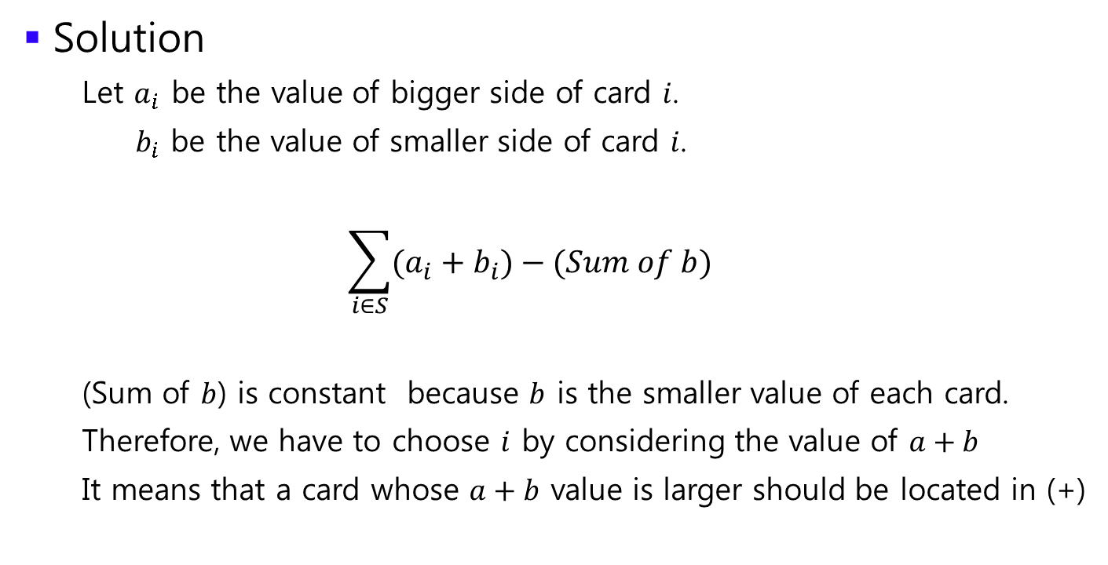
Other problems
Solution
Let $a_{i}$ be the value of bigger side of card $i$.
$b_{i}$ be the value of smaller side of card $i$.
$$\sum_{i∈S}{(a_{i}+b_{i})}−(Sum of b)$$
(Sum of $b$) is constant because $b$ is the smaller value of each card.
Therefore, we have to choose $i$ by considering the value of $a+b$
It means that a card whose $a+b$ value is larger should be located in (+)

Slide 79

Other problems
Solution
Sort cards with respect to the value of a + b
N cards whose value is larger should be located in (+)
Remaining N cards should be located in (-)
$$O(n\log{n)}$$

